Slide 1

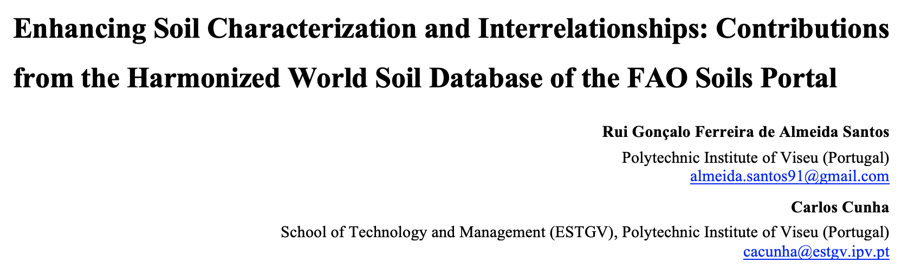

Slide 2
"Data is the new oil? No: Data is the new soil."
David McCandless

Slide 3

Comprehensive soil databases for effective management strategies
Effective Data Usage in Soil Management
fosters informed decision-making, crucial for effective soil management in dynamically changing environments.
Role of Data in Sustainable Practices
enhance the adoption of sustainable agricultural practices, ensuring long-term productivity.
Policy Development and Data Importance
formulate effective public policies aimed at sustainable land management.

Slide 4
Local data collection in soil studies
Importance of Local Soil Data Collection
critical insights into soil diversity and characteristics, essential for tailored environmental analyses.
Socioeconomic Indicators
enriches analyses and helps identify broader impacts on land management.
Complementing Remote Sensing Techniques
comprehensive soil assessments that consider on-the-ground realities.
Enhancing Data Relevance for Policymaking
Local data providing a strong foundation for evidence-based policymaking in environmental management.

Slide 5

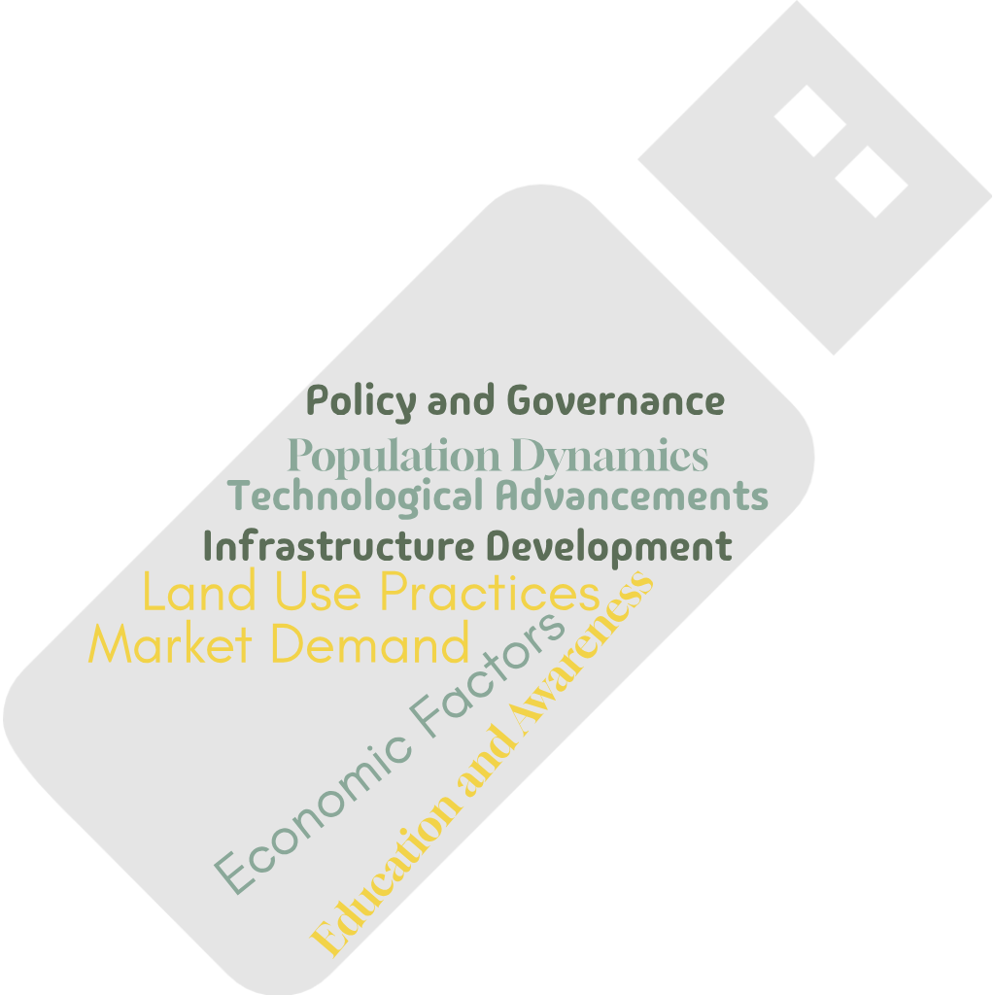
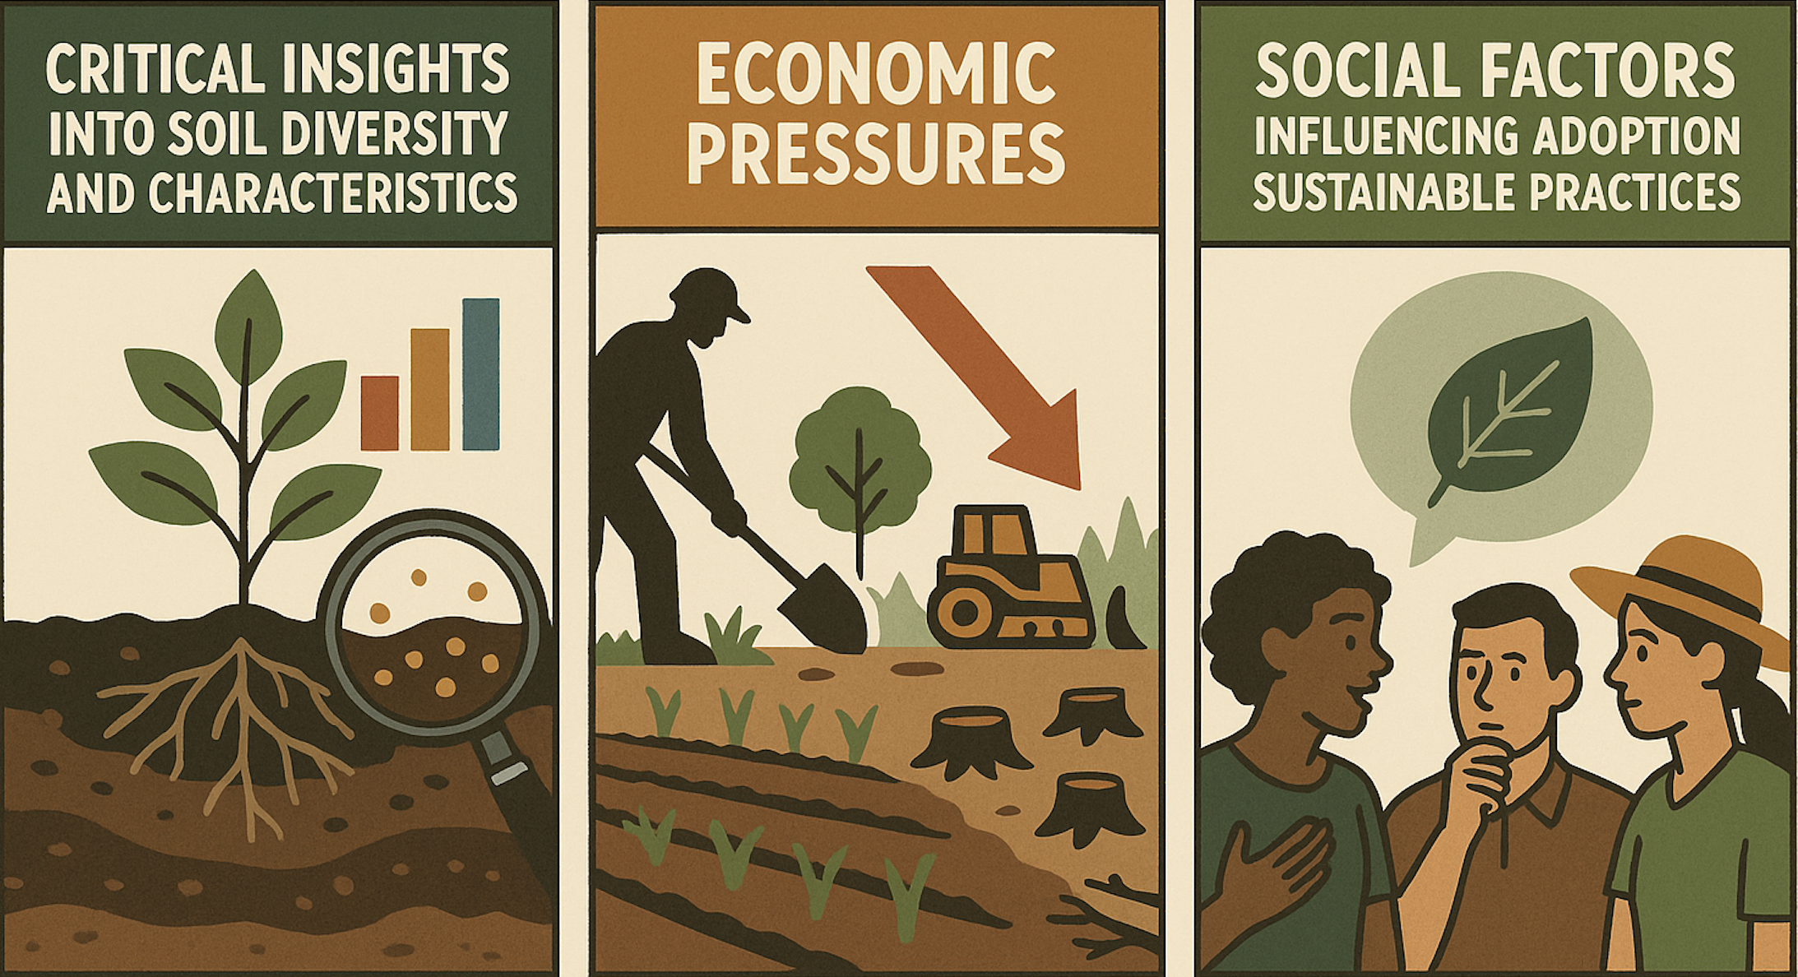
Climate
Socioeconomic

Slide 6
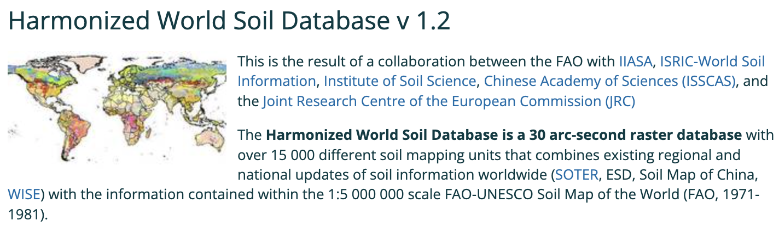



Methodology/Approach
Harmonized World Soil Database (FAO Soils Portal)
new variables related to climate conditions and socioeconomic dynamics
interconnections between soil attributes and other indicators.

Slide 7
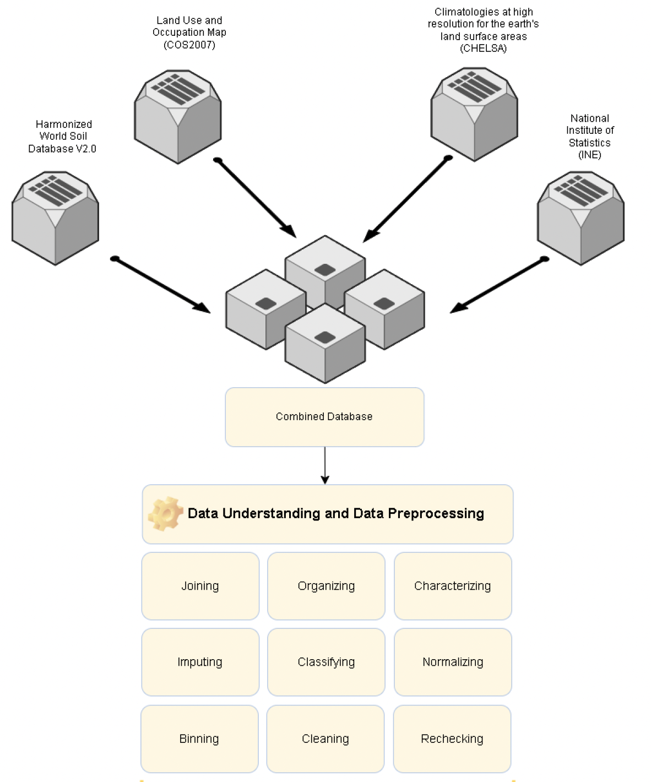
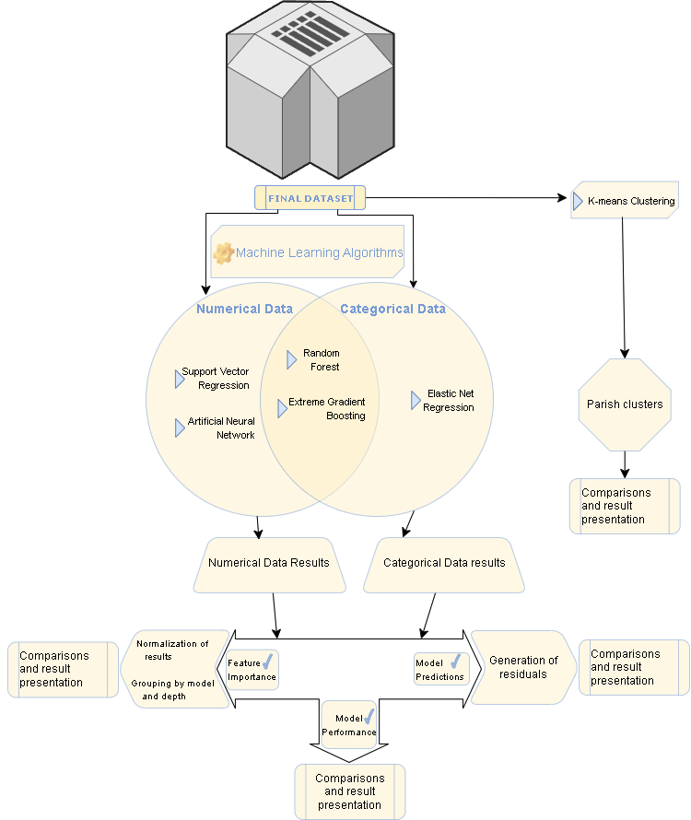

Slide 8
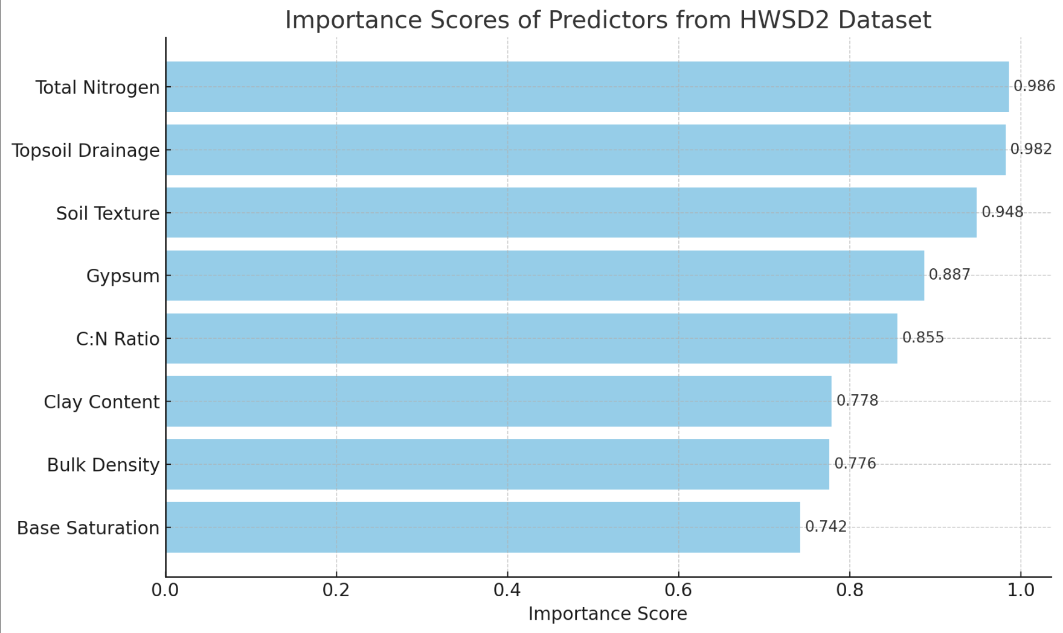
Harmonized World Soil Preliminary Results

Slide 9
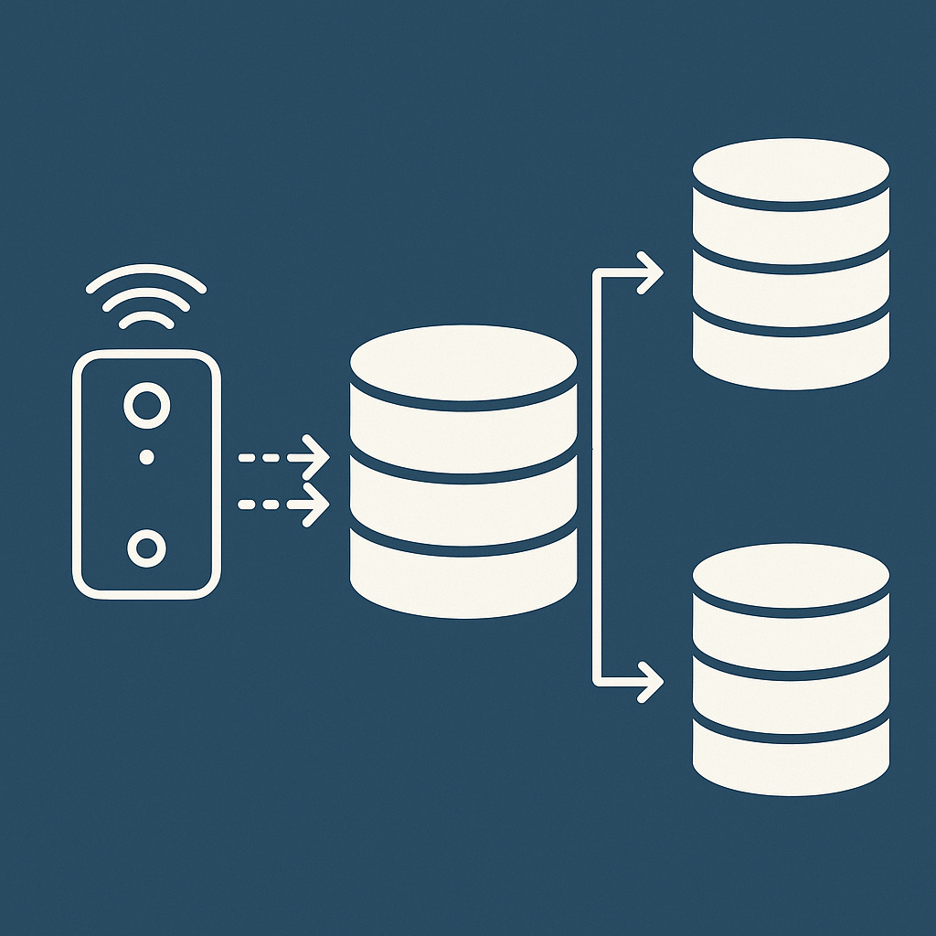
Expected Results
soil dynamics and interconnections in the Portuguese Framework
statistical information at the municipal level enables the interrelation with several other variables
knowledge obtained that can be considered as a basis for using science in defining public policies

Slide 10
?

